Slide 1
Ensemble Methods
Voting Classifier
Random Forests
AdaBoost

Slide 2
Ensemble Learning
Multiple predictors combined together is called an ensemble
An ensemble of predictors is better than each individual predictor.
Typically, once we have a set of promising models, we can apply ensemble learning to get even better performance.
Powerful because we can combine several weak learners to produce a high performing learner.

Slide 3
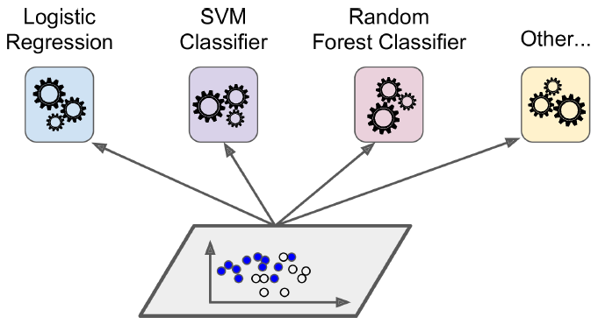
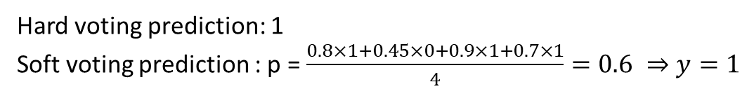
Voting Classifier
y=1
p = 0.8
y=0
p = 0.45
y=1
p = 0.9
y=1
p = 0.7
Like the name suggests, we take predictions from multiple predictors and predict the target by voting. This is called Hard Voting.
This method works best when the set of predictors are diverse.
By diverse, it means they make uncorrelated errors – they all don’t make the same mistakes while predicting.
To make the predictors as independent as possible, we choose different algorithms
Soft voting: If the predictors can output the probability, we can take a weighted average of the predictions.
Hard voting prediction: 1
Soft voting prediction : p = $\frac{0.8×1+0.45×0+0.9×1+0.7×1}{4}=0.6 ⇒y=1$

Slide 4
Bootstrap Estimation
Repeatedly draw n samples from training set of size D
For each set of samples, estimate a statistic
The bootstrap estimate is the mean of the individual estimates
Used to estimate a statistic (parameter) and its variance
Bagging: bootstrap aggregation (Breiman 1994)
This method can be used to create diverse estimators by training models on different subsets of data.

Slide 5
Bagging
The idea behind bagging is combining the results of multiple models (for instance, all decision trees) to get a generalized result.
Bootstrapping is a sampling technique in which we create subsets of observations from the original dataset, with replacement. The size of the subsets is the same as the size of the original set.
Bagging or Bootstrap Aggregating
Classifiers – aggregate is mode of predictions
Regressors – aggregate is mean of predictions
Steps in Bagging
Multiple subsets are created from the original dataset, selecting observations with replacement
A base model (weak model) is created on each of these subsets.
The models run in parallel and are independent of each other.
The final predictions are determined by combining the predictions from all the models.
Original Data
Original Data
Subset 1
Subset 2
Subset 3
Subset 4
Subset5
Subset 1
Subset 2
Subset 3
Subset 4
Subset 5
Model 1
Model 2
Model 3
Model 4
Model 5
Combined Prediction

Slide 6
Random Forests
This is basically a bagging classifier where the individual models are decision trees.
We already saw that the randomness comes from selecting different subsets of data for each model.
There is an additional randomness added by selecting only a subset of the features for individual trees.
Note that, bagging learners can train each model parallelly.
Subset of original data
containing only a subset of features
Original Data
Subset 1
Subset 2
Subset 3
Subset 4
Subset 5
DTree 1
DTree 2
DTree 3
DTree 4
DTree 5
Combined Prediction

Slide 7
Boosting
Another method to combine several weak learners.
The difference here is that individual models learn sequentially. Each model tries to perform better where the predecessor made mistakes.

Slide 8
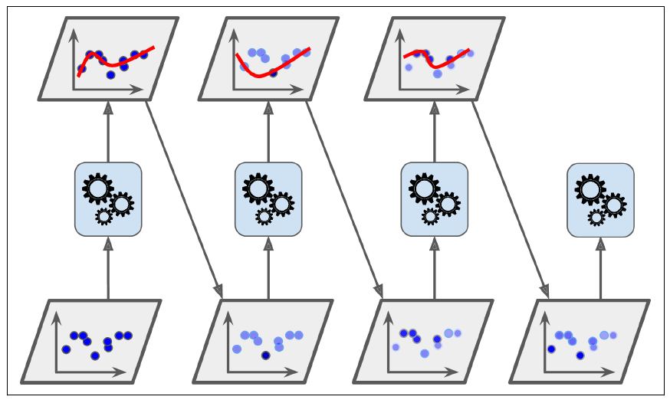
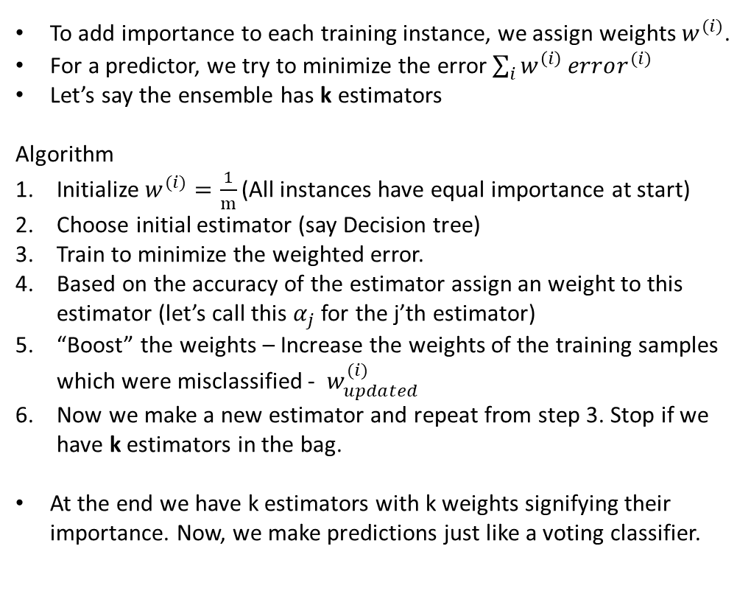
Adaptive Boosting (AdaBoost)
To add importance to each training instance, we assign weights $w^{(i)}$.
For a predictor, we try to minimize the error$\sum_{i}{w^{\left(i\right)}}error^{(i)}$
Let’s say the ensemble has k estimators
Algorithm
Initialize $w^{(i)}=\frac{1}{m}$(All instances have equal importance at start)
Choose initial estimator (say Decision tree)
Train to minimize the weighted error.
Based on the accuracy of the estimator assign an weight to this estimator (let’s call this $α_{j}$ for the j’th estimator)
“Boost” the weights – Increase the weights of the training samples which were misclassified - $w_{updated}^{(i)}$
Now we make a new estimator and repeat from step 3. Stop if we have k estimators in the bag.
At the end we have k estimators with k weights signifying their importance. Now, we make predictions just like a voting classifier.

